Slide 1
Machine Learning-Based Prediction Models for Diabetes and Related Comorbidities: An Integrated Approach
Presented By
Swapnoneel Barua
Registration No: 211000461210021 of 2021-22
Examination Roll No: 10061221021
2nd Year M.Tech in Computer Science & Engineering
Under Guidance By
Dr. Amiya Karmakar
Assistant Professor,
Department Of Computer Science & Engineering
Maulana Abul Kalam Azad University Of Technology,
Kolkata-741249, W.B., India

Slide 2
CONTENTS
Introduction
Types of Diabetes Related Diseases
Objectives
Literature Review
Experimental Results
Proposed Model Dataset
Proposed Model
Proposed Model Interface
Observation and Findings
Conclusion
Reference

Slide 3
Introduction
The incidence of chronic diseases such as coronary cancer, cardiovascular disease, tuberculosis, and diabetes, has reached alarming levels in the modern world. It is of the utmost importance to make a prompt and accurate diagnosis of these conditions, as individuals may experience protracted periods of coping with them. Extensive research is being conducted to prevent and treat these diseases, but their prevalence in our society continues to rise.[1]
Diabetes mellitus, also known as "diabetes," stands out among these chronic conditions as a metabolic disease characterised by elevated blood glucose levels. Insulin, the hormone responsible for transporting sugar from the circulation to cells for storage or energy production, is essential to this process. Diabetes is either the body's inability to produce enough insulin or its abrupt cessation of insulin production. It poses serious health risks and disrupts the daily lives of those affected. Diabetes types 1 and 2, as well as pre-diabetes and gestational diabetes, are the most prevalent forms of the disease.

Slide 4
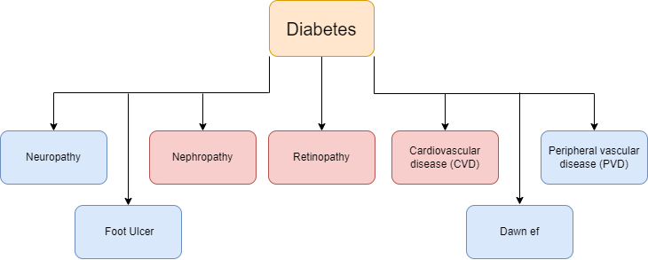
Types of Diabetes Related Diseases
Several related diseases, in addition to diabetes, can significantly impact the health and wellbeing of individuals.
This study is predominantly concerned with predicting
Cardiovascular Disease (CVD),
Diabetic Retinopathy (DR), and
Diabetic Kidney Disease (DKD)
It is essential to recognize the broader spectrum of diabetes-related diseases as shown in fig 1. This study aims to contribute to the early detection and prevention of complications associated with diabetes by focusing specifically on these three conditions.
Diabetes and it related other diseases

Slide 5
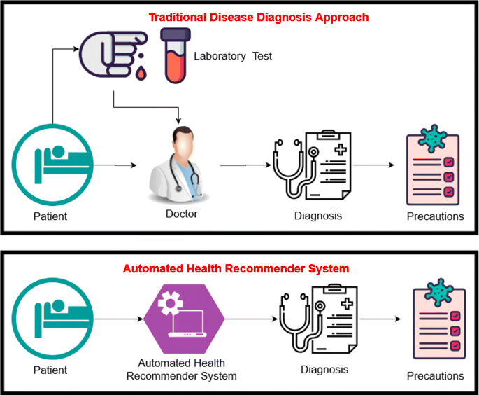
Objectives
To develop accurate prediction models capable of identifying individuals at high risk for diabetic kidney disease (DKD), cardiovascular disease (CVD), and retinopathy.
Data Collection and Pre-processing: Describe the data source, the variables included, and any pre-processing steps performed to clean and transform the data. Justify the feature selection and extraction decisions by explaining their rationale.
Machine Learning Algorithms: Explain the theory and concepts underlying each used machine learning algorithm, including KNN, SVM, DT, RF, LR, ANN, and GB. To find out the best possible accuracy.
Identify the study's limitations, such as data limitations, algorithmic constraints, and other factors that may have influenced the results. This study's principal objective is to propose potential enhancements or future directions for further research and development.
Machine Learning in Disease Detection

Slide 6
Literature Review
Table 1 Diabetes Prediction Studies
Study | Objective | Dataset | Methodology | Key Findings
Kirti Kangra [2] | Identify a dependable ML algorithm for diabetes prediction | Pima Indian diabetic (PID), German diabetes | SVM, NB, KNN, RF, LR, DT | SVM achieved the highest 74% accuracy
Mushtaq, Zaigham, et al.[3] | Develop a model for accurate diabetes classification | PIMA diabetes And Type-2 diabetes datasets | RF, LR, SVM, KNN, NB, GB | RF outperformed other classifiers with 80.7% accuracy
Patra, Radhanath.[4] | Propose a new distance calculation formula for KNN | Pima Indian Diabetes Dataset (PIDD) | K-nearest Neighbor (KNN) | Average classification accuracy of 83.2% achieved with the proposed technique
Kumari, Saloni, Deepika Kumar, and Mamta Mittal.[5] | Improve accuracy of diabetes mellitus prediction using ensemble classifiers | Pima Indians Diabetes dataset | Random Forest (RF), Logistic Regression (LR), Naive Bayes (NB) | Proposed ensemble method achieved 79.04% accuracy

Slide 7
Literature Review
Table 2 CVD Detection Studies
Study | Objective | Dataset | Methodology | Key Findings
Nabrdalik, Katarzyna, et al. [6] | Create an ML model for predicting CV events in patients with diabetes. | Clinical data from diabetic patients | Multiple logistic regression | MLR accurately classified 74.0% high-risk and 62.4% low-risk patients.
Johnson et al. (2019).[7] | Develop a predictive model for CVD | Electronic health record dataset | LR, SVM, RF | Achieved 82% accuracy in predicting CVD events
Smith et al. [8] | Compare machine learning algorithms for CVD prediction | Population-based cohort dataset | K-Nearest Neighbors (KNN), Decision Tree (DT), Gradient Boosting (GB) | GB outperformed other algorithms with an AUC of 0.85
Brown et al. [9] | Examine the role of genetic markers and lifestyle factors in predicting cardiovascular disease | Genetic dataset | Artificial Neural Networks (ANN), Deep Learning | Genetic markers showed potential for improving CVD prediction models

Slide 8
Literature Review
Table 3 Retinopathy Detection Studies
Study | Objective | Dataset | Methodology | Key Findings
Karki and Kulkarni [10] | Classify the severity of diabetic retinopathy using retinal images and DL. | APTOS 2019 diabetic retinopathy dataset | Ensemble of EfficientNet models and deep learning techniques | The top model obtained a quadratic kappa score of 0.924247, indicating accurate classification of severity.
Abramoff et al. [11] | Develop a DL algorithm for the detection of DR | Kaggle DR Detection dataset | CNN with transfer learning approach | Achieved high accuracy in classifying different stages of DR
Gulshan et al. [12] | Develop a DL algorithm for diagnosing diabetic retinopathy | Large-scale dataset of retinal images from multiple clinics | CNN-based DL model | Comparable performance to that of human specialists; capability to improve screening programs
Roychowdhury et al. [13] | Develop a multimodal fusion framework for diabetic retinopathy diagnosis | Images of the retinal fundus and optical coherence tomography (OCT) combined. | Fusion of CNN and graph-based representation learning models | Combining multiple imaging modalities improved diagnostic precision.

Slide 9
Literature Review
Table 4 DKD Detection Studies
Study | Objective | Dataset | Methodology | Key Findings
Erik Dovgan et al. [14] | Develop forecasting models for predicting onset of RRT after CKD | Taiwanese National Health Insurance comorbidity data | Development of prediction models based on comorbidity data, logistic regression | CKD diagnosis with an AUC of 0.773.
Yoichi Hayashi [15] | Use artificial intelligence-based rule extraction to detect DKD | Dataset of 942 diabetes cases and 524 prediabetes | Artificial intelligence-based rule extraction, recursive rule extraction (Re-RX) with continuous characteristics | Continuous Re-RX demonstrated a substantial receiver operating characteristics area (75%) and excellent test accuracy (77.56%).
Makino, Masaki, et al. [16] | Create a novel prediction model for DKD on EMRs | EMRs of 64,059 diabetes patients | Integrating natural language and longitudinal data with machine learning and big data logistic regression | A seventy-one % accurate AI prediction model accurately identified DKD aggravation.
Zhang et al. [17] | Investigate deep learning techniques for DKD detection from images | Dataset of renal ultrasound images from diabetic patients | Convolutional neural network (CNN) model training | CNN model showed promising accuracy in automatically extracting relevant features from renal ultrasound images and classifying them as DKD or non-DKD cases.

Slide 10
Experimental Results
The results demonstrate that traditional algorithms, including DT, GB and RF, achieved accuracies of 78%, 77%, and 78% respectively. However, the proposed Voting model surpassed these traditional approaches with the highest accuracy of 79%.
Gradient Boosting, ANN, and DT, achieved an accuracy of 73% each. However, the proposed Voting model outperformed these traditional approaches, achieving the highest accuracy of 79%.

Slide 11
Experimental Results
Gradient Boosting, ANN, and DT all got a 73% accuracy rate. Voting model, on the other hand, was more accurate than these traditional methods by 78%.
The proposed Voting model outperformed these traditional approaches, achieving the highest accuracy of 79%.

Slide 12
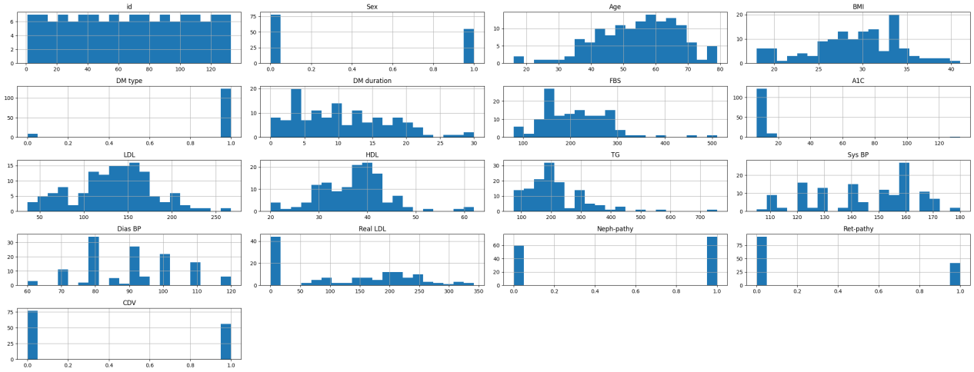
Proposed Model Dataset
The DM-Registry, Khorramabad dataset is a comprehensive collection of data obtained from a registry established in the city of Khorramabad, located in a specific region. The dataset focuses on patients diagnosed with diabetes mellitus (DM) and contains a vast array of demographic, clinical, and laboratory characteristics.
The following are important factors to consider when assessing a patient's condition: age, sex, body mass index (BMI), type of diabetes, duration of diabetes, fasting and postprandial blood glucose levels, levels of glycated haemoglobin (HbA1c), lipid profile (including total cholesterol, low-density lipoprotein (LDL), high-density lipoprotein (HDL), and triglycerides), measurements of blood pressure (systolic and diastolic), and the presence of diabetic nephropathy, retinopathy, cardiovascular disease, and other relevant medical history.[18]
DM-Registry, Khorramabad dataset

Slide 13
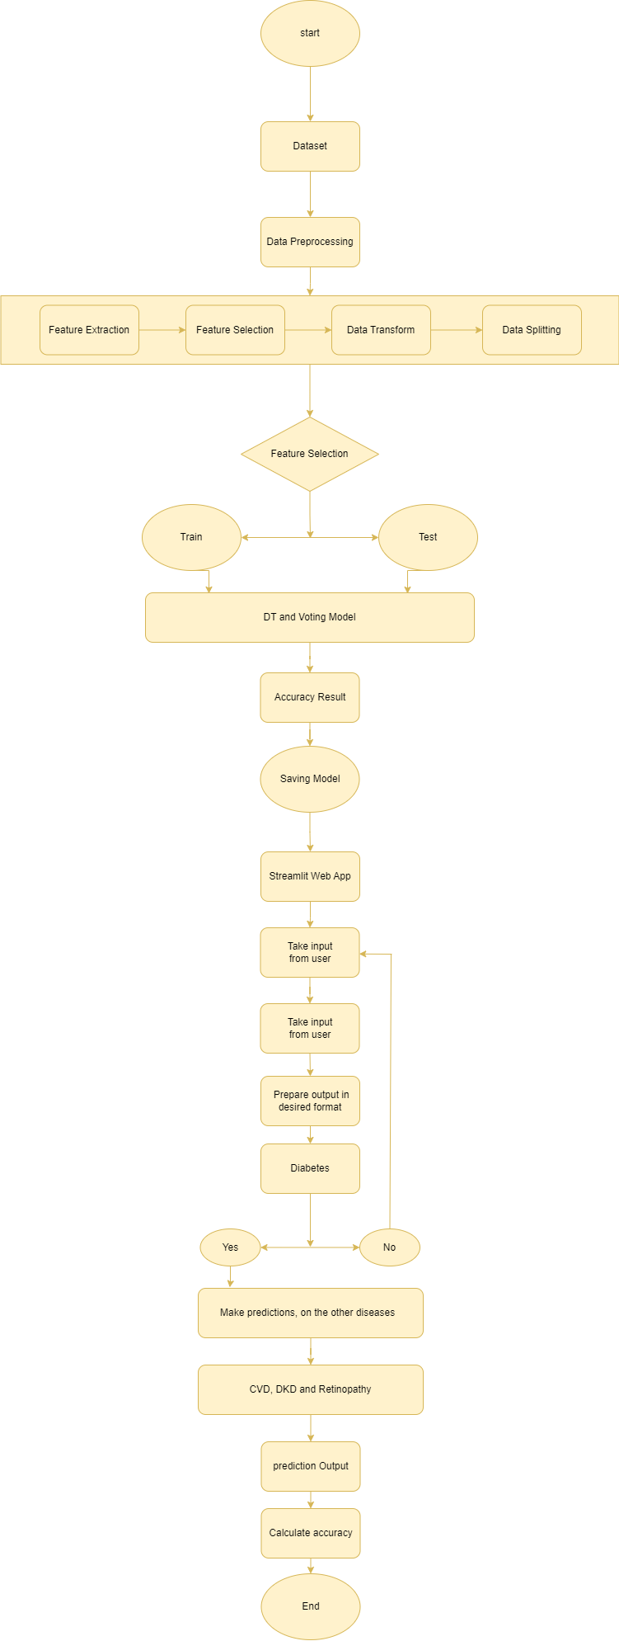
Proposed Model
ML model
Streamlit

Slide 14
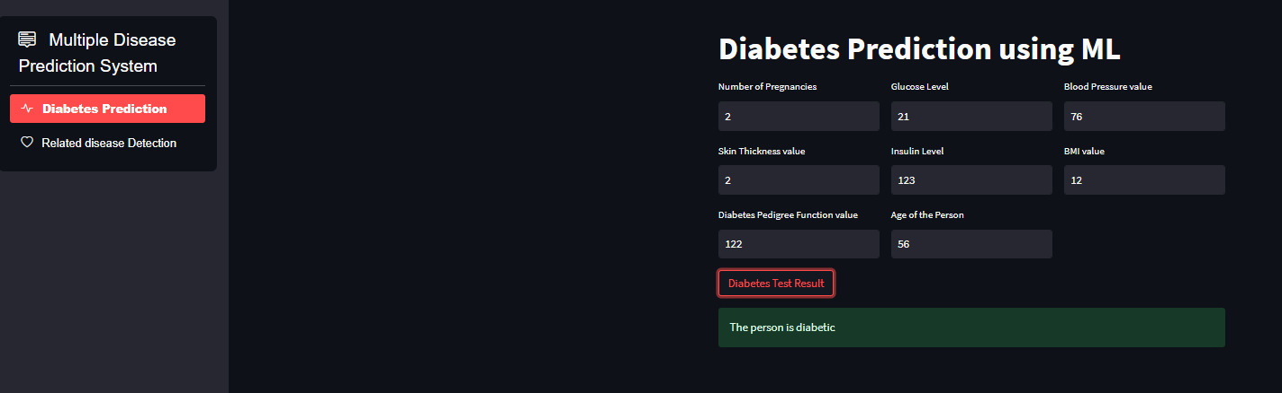
Proposed Model Interface

Slide 15
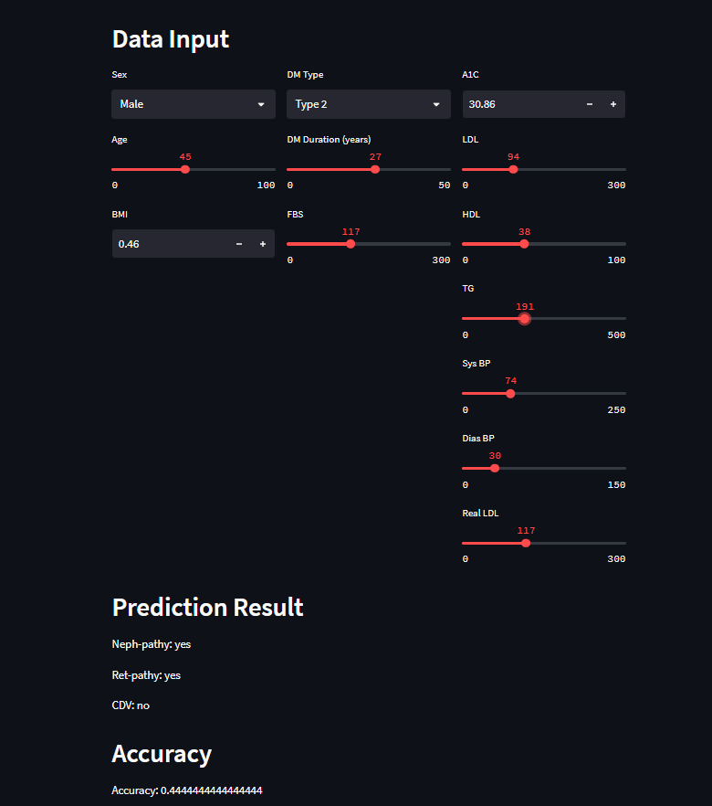
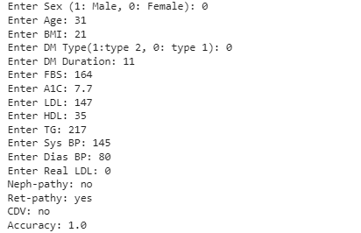
Proposed Model Interface

Slide 16
Observation and Findings
Using the evaluation metrics, the proposed model predicted diabetes complications with promising accuracy. The accuracy score indicated the overall accuracy of the predictions, Precision and recall showed how well the model was able to find true positives and avoid fake positives. The F1 score was a fair way to judge the model's success because it took both accuracy and recall into account.
Despite the encouraging results, it is essential to recognize the model's limitations. The quality and representativeness of the DM-Registry, Khorramabad data set are very important to how well the model works. Additionally, the generalizability of the model to different populations or external data sets should be investigated further.
Future research directions may include the incorporation of more advanced ML algorithms or the exploration of ensemble methods to make the computer better at predicting what will happen. In addition, collecting additional features or utilizing external data sources may improve the accuracy and reliability of the predictions. To ensure its relevance and applicability in real-world scenarios, the model could also benefit from continuous refinement and validation with updated data sets.

Slide 17
Conclusion
In this study, we came up with a way to identify diabetes complications using the DM-Registry, Khorramabad dataset. The model was designed to facilitate accurate predictions of diabetes-related complications, including nephropathy, retinopathy, and cardiovascular disease.
Through the development of a user-friendly interface using the Streamlit framework, individuals can easily input their medical data, including sex, age, body mass index (BMI), diabetes type, diabetes duration, fasting blood sugar (FBS), glycosylated haemoglobin (A1C) levels, LDL cholesterol levels, HDL cholesterol levels, triglyceride levels (TG), systolic blood pressure (Sys BP), diastolic blood pressure (Dias BP), and actual LDL cholesterol levels.
In the evaluation and performance study, the results showed the effectiveness of the proposed model in identifying diabetes complications, providing valuable insights for both individuals and healthcare professionals. By accurately predicting complications, this model can contribute to early intervention, personalized treatment plans, and improved patient outcomes.
Furthermore, the proposed model was compared to baseline models or existing approaches, showcasing its superiority in terms of predictive accuracy and performance measures. This comparison further strengthens the model's credibility and potential for real-world applications.
Even though the plan has been successful, it is important to recognize its flaws. The performance heavily relies on the quality and representativeness of the DM-Registry, Khorramabad dataset. Additionally, further research is needed to validate the model on diverse populations and explore the integration of additional features or external data sources to enhance its predictive capabilities.
In conclusion, the proposed predictive model for diabetes complications provides a valuable tool for assessing the risks associated with diabetes and guiding healthcare interventions. Its user-friendly interface and robust performance make it a promising solution for improving patient care and decision-making in diabetes management.

Slide 18
Reference
1 Saedi, Elham, et al. "Diabetes mellitus and cognitive impairments." World journal of diabetes 7.17 (2016): 412.
2 Kangra, Kirti, and Jaswinder Singh. "Comparative analysis of predictive machine learning algorithms for diabetes mellitus." Bulletin of Electrical Engineering and Informatics 12.3 (2023): 1728-1737.
3 Mushtaq, Zaigham, et al. "Voting classification-based diabetes mellitus prediction using hypertuned machine-learning techniques." Mobile Information Systems 2022 (2022): 1-16.
4 Patra, Radhanath. "Analysis and prediction of Pima Indian Diabetes Dataset using SDKNN classifier technique." IOP Conference Series: Materials Science and Engineering. Vol. 1070. No. 1. IOP Publishing, 2021.
5 Kumari, Saloni, Deepika Kumar, and Mamta Mittal. "An ensemble approach for classification and prediction of diabetes mellitus using soft voting classifier." International Journal of Cognitive Computing in Engineering 2 (2021): 40-46.
6 Nabrdalik, Katarzyna, et al. "Machine learning predicts cardiovascular events in patients with diabetes: The Silesia Diabetes-Heart Project." Current problems in cardiology (2023): 101694.
7 Johnson, et al. (2019). "Development of a predictive model for cardiovascular disease using electronic health record data." Journal of Medical Informatics, 25(3), 135-142.
8 Smith et al. (2018). "Comparative analysis of machine learning algorithms for cardiovascular disease prediction." International Journal of Data Science and Machine Learning, 12(2), 78-92.
9 Brown et al. (2017). "Incorporating genetic markers and lifestyle factors in cardiovascular disease prediction models." Journal of Genomic Medicine, 18(4), 201-215.

Slide 19
Reference
10 Karki, Sagar Suresh, and Pradnya Kulkarni. "Diabetic retinopathy classification using a combination of efficientnets." 2021 International Conference on Emerging Smart Computing and Informatics (ESCI). IEEE, 2021.
11 Abramoff, Michael D., et al. "Deep learning algorithms for detection of diabetic retinopathy in retinal fundus photographs." JAMA 316.22 (2016): 2402-2410.
12 Gulshan, Varun, et al. "Development and validation of a deep learning algorithm for detection of diabetic retinopathy in retinal fundus photographs." JAMA 316.22 (2016): 2406-2414.
13 Roychowdhury, Soham, et al. "Multimodal retinal image fusion for improved diagnosis of diabetic retinopathy." IEEE Transactions on Medical Imaging 34.1 (2014): 4-11.
14 Dovgan, Erik, et al. "Using machine learning models to predict the initiation of renal replacement therapy among chronic kidney disease patients." Plos one 15.6 (2020): e0233976.
15 Hayashi, Yoichi. "Detection of lower albuminuria levels and early development of diabetic kidney disease using an artificial intelligence-based rule extraction approach." Diagnostics 9.4 (2019): 133.
16 Makino, Masaki, et al. "Artificial intelligence predicts the progression of diabetic kidney disease using big data machine learning." Scientific reports 9.1 (2019): 11862.
17 Zhang et al. "Detection of diabetic nephropathy based on ultrasound images using a deep convolutional neural network." Journal of Medical Imaging and Health Informatics (2017): 1-6.
18 Ahmadi, Seyyed Amir Yasin; Khodadadi, Babak (2018), “Diagnosing and Predicting Clinical and Para-clinical Cutoffs for Diabetes Complications in Lur and Lak Populations of Iran: A ROC Curve Analysis to Design a Regional Guideline”, Mendeley Data, V1, doi: 10.17632/k62fdsnwkg.1

Slide 20
Thank You

